Slide 1
DOING DATA SCIENCE
IN SERVICE OF THE PUBLIC GOOD
Community Learning through Data Driven Discovery (CLD3)
Stephanie Shipp
Acting Division Director, Social and Decision Analytics
Data Science for the Public Good
May 31, 2023
Notes:
Thank you - been an exciting day. First let me share about my home institute.
Five pillars –
data acquisition,
engineering,
analysis,
dissemination, and
ethics

Slide 2


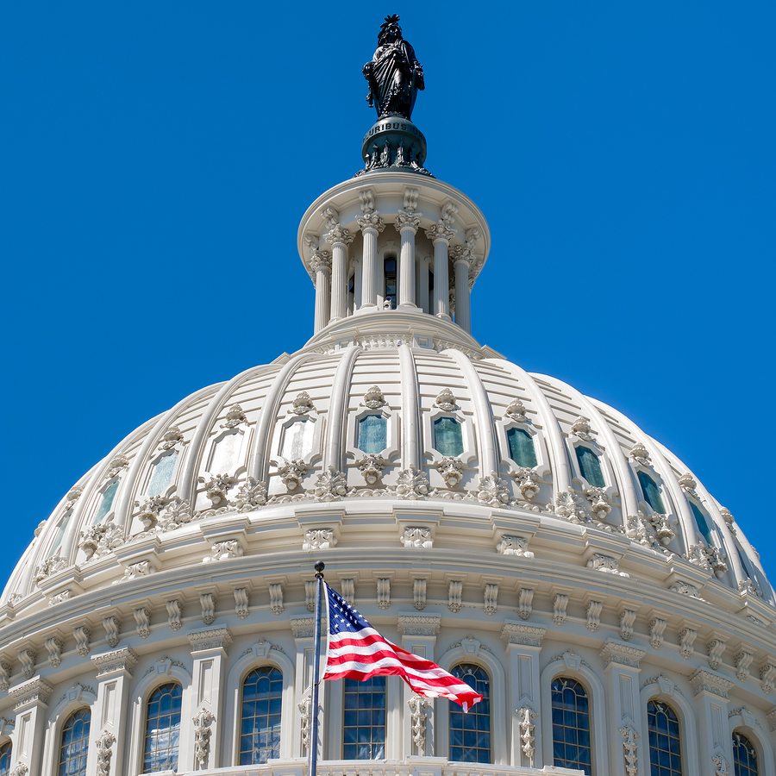
Biocomplexity Institute
Team science exploring the behavior of massively interacting living systems to develop practical solutions to real-world problems.
Mathematical Biocomplexity
Network Systems Science
and Advanced Computing
Social and Decision Analytics
3
Notes:
Let me step back and tell you about us.
We are a data science research division in the Biocomplexity Institute at the U of Virginia.
Scientists in our institute conduct research that spans from theoretical bench biology at the molecular level and scales to societies and populations, driving to evidence-based policy.
Our research group is on the societies and populations side of this mission.
Our work brings together a variety of local, state, and federal survey and administrative data, opportunity data scraped from the web, and procedural data,
We use a mix of statistical, geospatial, and machine-learning methods.
We are Statisticians and Social and Behavioral Scientists who have a passion for improving the quality of life for everyone through data.
Unlike many centers, we are full-time researchers

Slide 3
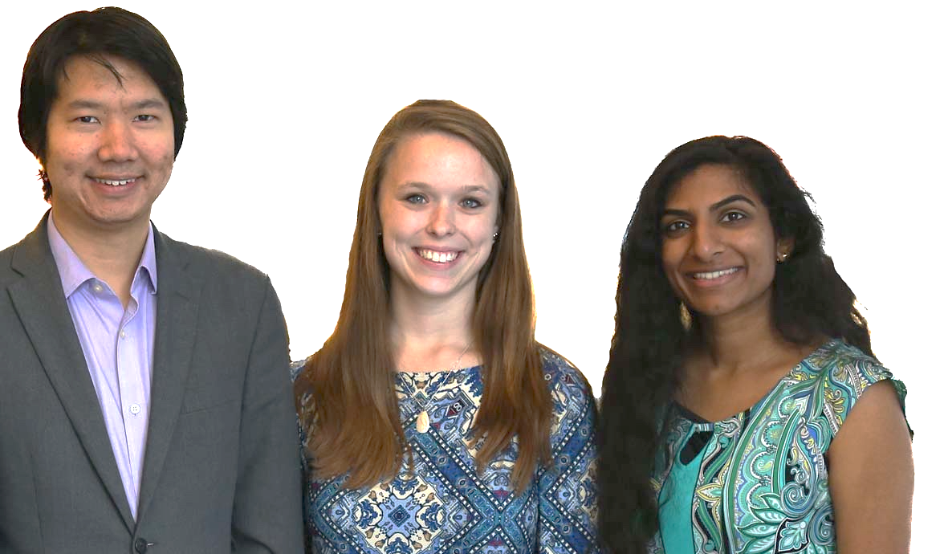
Data Science for the Public Good Students
Hannah Brinkley
Daniel Chen
Ronnie Fecso
David M. Hinkle
Zarni Htet
Eirik Iversen
Claire Kelling
Joseph Kim
Lata Kodali
Chanida Lerdritsomboon
Megan Grondine
Cory Kim
Luke Kim
Doug Mattingly
Kelsey McMahon
Armi Mosavian
Alexa Nosal
Sawhney, Raghav
Weerasu Warajuntano
Daniel Liden
Craig Morton
Calvin Isch
Jessica Keast
Sarah McDonald
Sean Pietrowicz
Sawhney, Raghav
Eliza Tobin
Daniel Bullock
Lara Haase
Madeline Claire Pickens
Susweta Ray
Finn Axel Roberts
Mary Solomon
Morgan Stockham
Riya Berry
Tasfia Chowdhury
Martha Czernuszenko
Chase Dawson
Gina Fendley
Ellen Graham
Aditi Mahabal
David Healey
Brian Che
Catherine Irons
Kyle Morgan
Saimun Habib
Owen Hart
Morgan Klutzke
Ian MacLeod
Elizabeth Miller
Vatsala Ramanan
Joanna Schroeder
Crystal Zang
Emily L Kurtz
Digvijay Ghotane
Crystal Zang
Davon Woodard
Emily Sheen
Fanfang Lee
Devika Nair
Allegra Pocinki
Alyssa Fowers
Cong Cong
Quinton Neville
Tina Highfill
Jessica Phelan
Emily Kurtx
Heleigh Tomlin
Daniel Wilkin
Dahnielle Milton
Suliah Apatira
Isabel Gomez
Victoria Halewicz
Keren Chen
Morgan Stockham
Suscheta Sharma
Aditi Mahabal
Cierra Oliveira
Haleigh Tomlin
Asia Porter
Stephanie Zhang
Akilesh Ramakrishna
Harsimrat Pandher
David Park
Sayali Phadke
Adrienne Rogers
Sean M. Pili
Ben Swartz
Alexis Bernal
Chase Dawson
Madeline Garrett
Aditi Mahabal
Kateryna Savchyn
Notes:
We have had a large collection of students that have worked with us over the years through our Data Science for the Public Good Program summer programs and during the year.

Slide 4
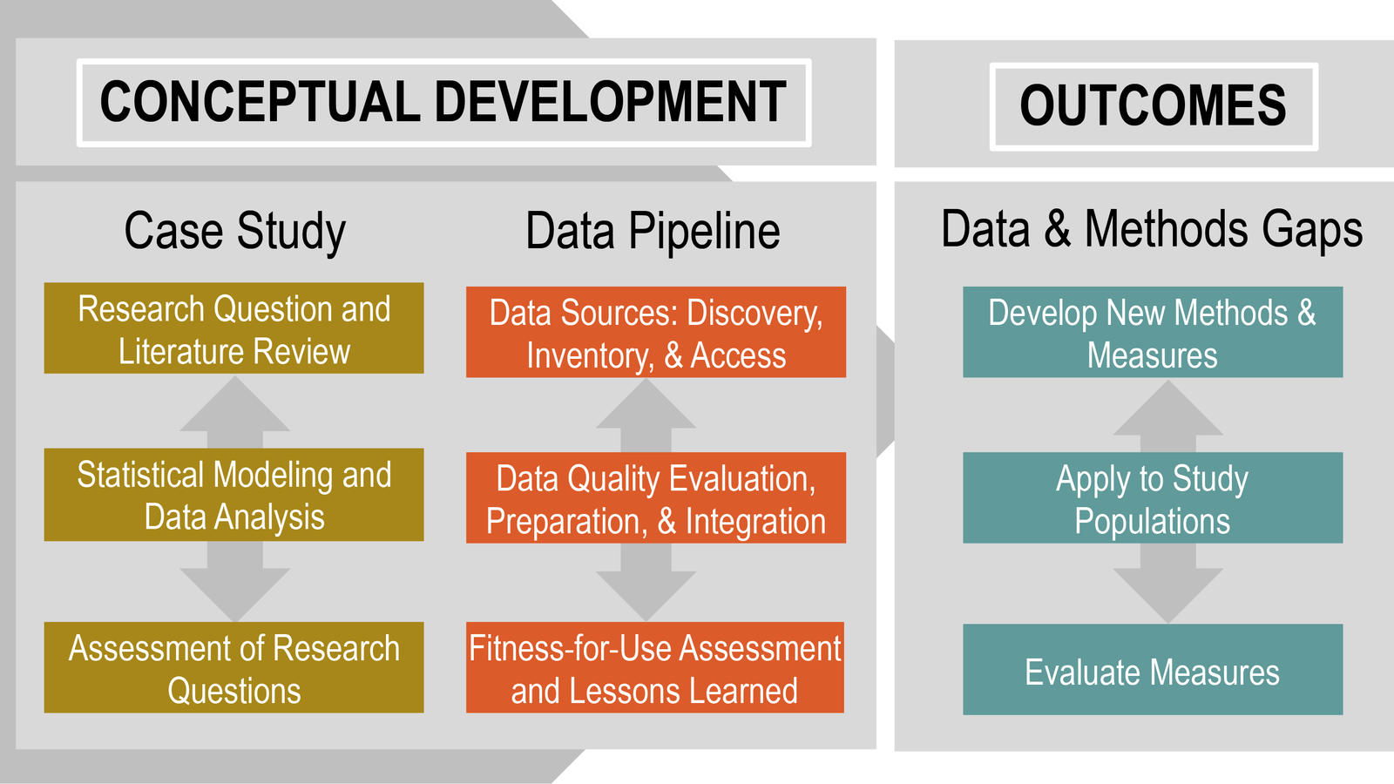
Our data science research model
Notes:
Our organization has a fundamental research model that we think about as we are developing our projects and programs.
I like to use our Executive Director words that we work to address Other People’s Problems (OPPs).
This is a diagram of how we approach our work.
We focus heavily on the case studies and problems that sponsors have
A hallmark of our data pipeline is data discovery where we set out to discover all possible data sources and methods and that might be used to address these problems or issues.
That is in the true data science spirit that without problems, there is no data science.
Once we are immersed in the methods and analysis, we can characterize gaps in our knowledge, gaps in our data, and gaps in our methods which then drives more data collection and the development of methods.
Our approach is to do applied research and out of that comes new fundamental research.

Slide 5










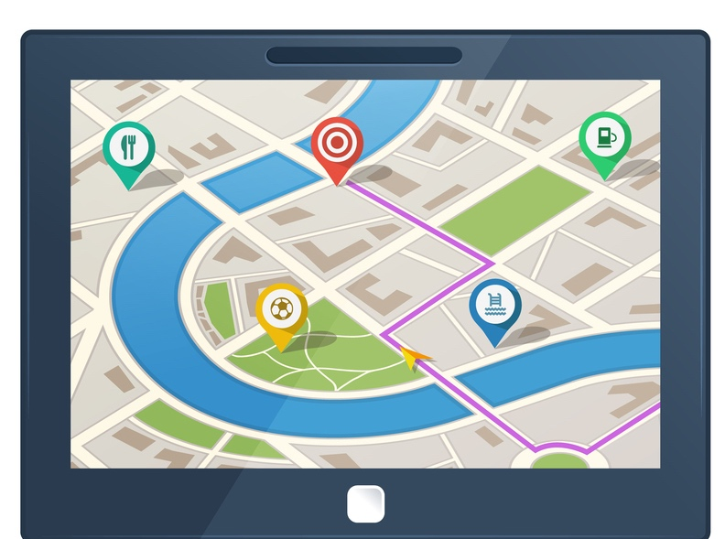

Measurement: data repurposing
How data are born
Designed Data
Administrative Data
Opportunity Data
Procedural Data
Opportunity
Data
Procedural Data
Notes:
To reinforce our data science research model, we first repurpose data, identify gaps, and only then seek to do new data collection.
When we seek to discover data and repurpose for our uses, we find it helpful to bin into four types of data
Designed data from surveys and experiments
Administrative data collected for running a program
Opportunity data that we scrape from the website
And Procedural data that ranges from an algorithm for a red light, to laws, to policies for running programs.
Key to using different types of data is knowing their provenance or why they were born.
When repurposing data for statistical analysis, we want to understand their data quality and representativeness.

Slide 6

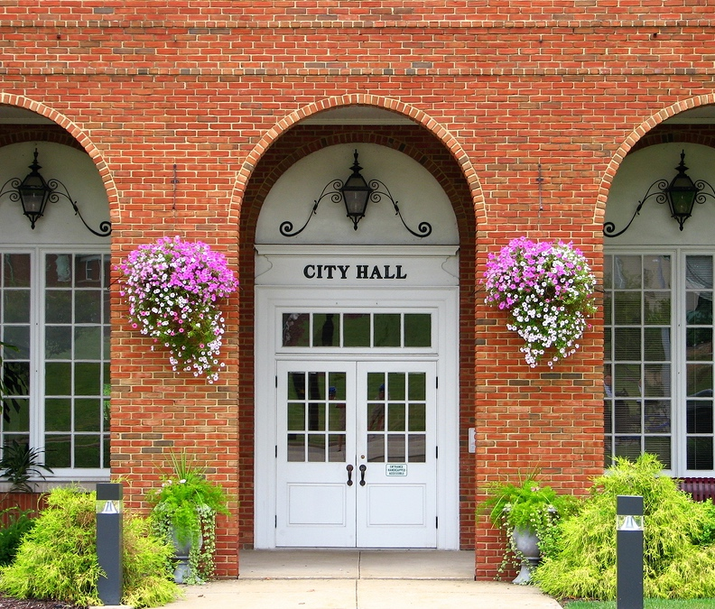
Our data science partners
Industry
Federal Statistical Agencies
DOD: U.S. Army
Local Government
Notes:
We have had a rich set of data partners over the years. Industry, the the DOD, particularly the Army, federal statistical agencies, and local and rural govt.

Slide 7
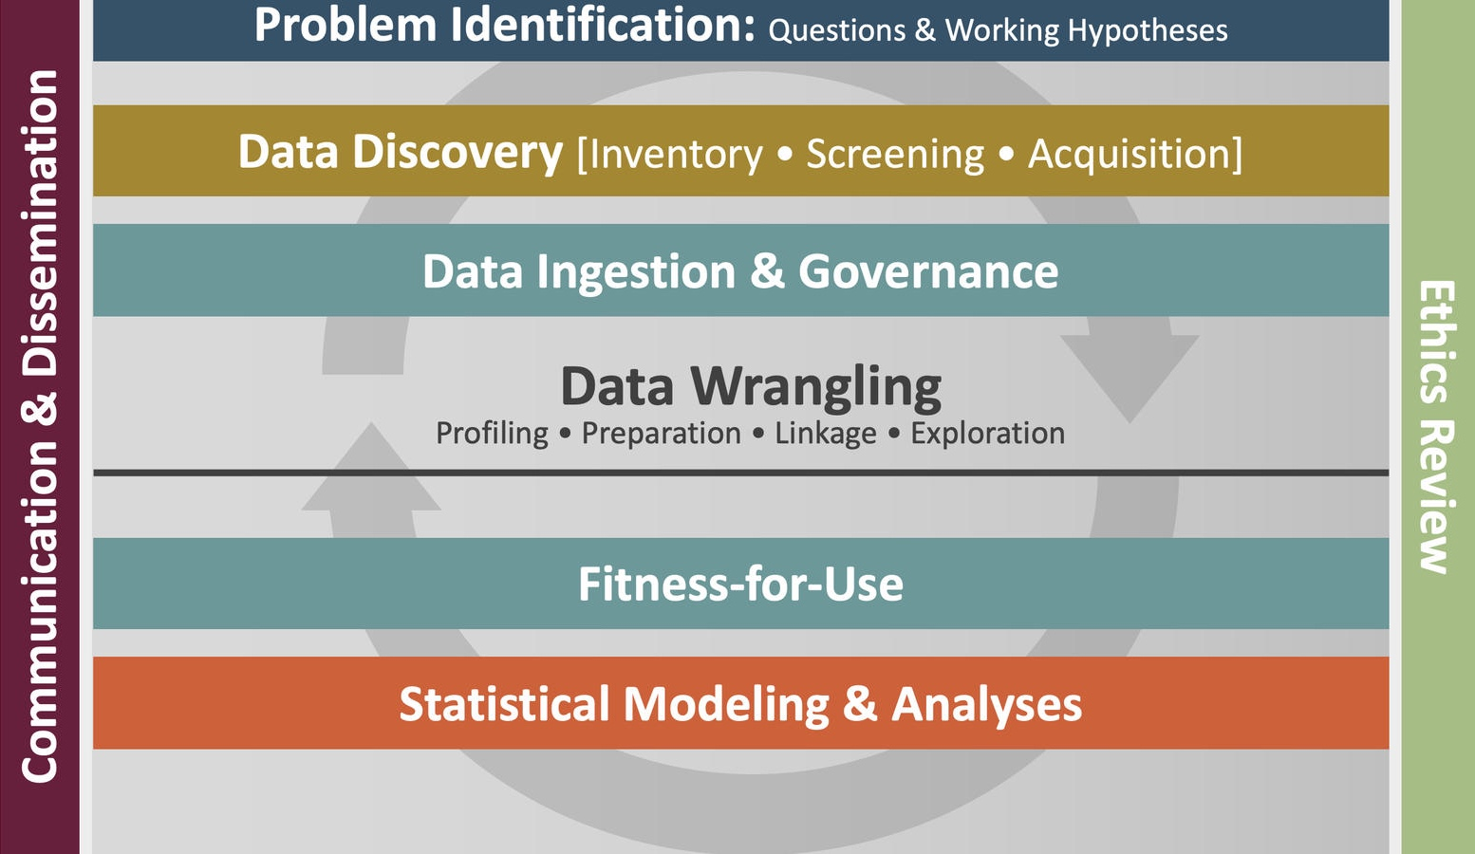
Our data science framework
Notes:
Out of working with these partners has led to the development of fundamental research which has led to our data science framework.
This DSF might look simple when you see it but is actually quite rich in the steps that guide our work. It took a lot of research doing many case studies to articulate this framework.
It now forms a transparent scaffold that guides our data science work,
It starts with a problem
Moves into data discovery where we try to think as imaginatively as we can to find all the different data sources that might be out there in the wild that can be brought to bear on this problem,
This leads to data ingestion and governance.
That leads to massive repurposing and wrangling of these data to bring them together to understand their fitness for use and different statistical modeling and analysis.
And really important are these outside bars that touch every step of this process is around ethics and communication
In particular, since we are using massive amounts of data for purposes that they were not initially developed, it becomes really critical that we think about ethics and how we communicate this back.
.

Slide 8

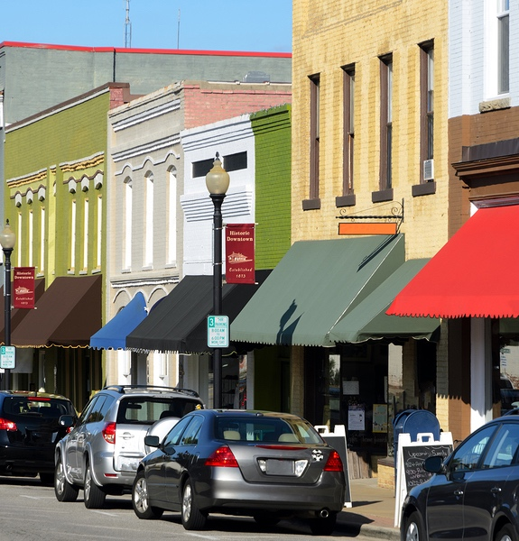
Metropolitan to Main Street
Notes:
So that is our fundamental research model and DSF that had evolved out of our work,
I want to talk about a window into the future to share how we are working with our partners that is driving where our division is going in the coming years.
Let’s start with local govt.
From a local govt perspective, we have worked with metropolitan areas like the Washington DC metro area to main street in rural areas.

Slide 9




Out of the Office
into the Community
Notes:
What we have learned is that if you are going to work with local communities and local government is that you get out of the office and into the communities to actually start to engage with the stakeholders in the community.
This is really important for working OPPs and that is what we do in the Biocomplexity institute

Slide 10
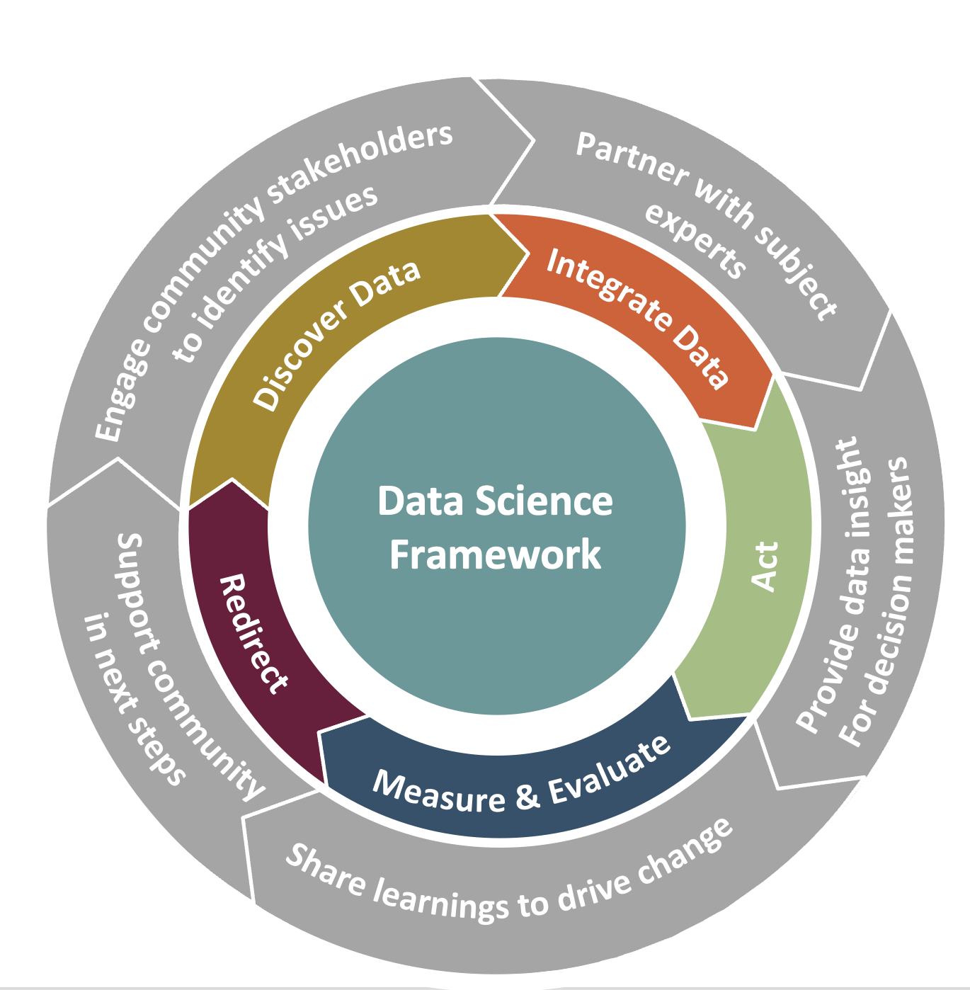
Our Community Engagement Process
Community Learning through Data Driven Discovery (CLD3)
Our data science framework
Notes:
Out of this work has come our community engagement framework,
We call this our Community Learning through Data-Driven Discovery (CLD3) process.
In this picture, what you will notice is that the outside circle is where the engagement with community stakeholders occurs in the context of a local community,
This outer wheel is the continuous interaction and communication across stakeholders.
We engage with the community to identify their issues, partner with subject matter experts, provide data insights to the community, share learning to drive change, and support the community in the next steps. We facilitate these interactions,
The middle wheel is the data-driven learning process. This is at the heart of what we do, We can take their problems and put them in a data context or a biocomplexity context.
We go through data discovery, build and share data insight. The community can then take action, measure and evaluate, redirect resources, and continue the process iteratively.
What makes these processes different than other collective action processes is the DSF that I just showed you is at the center of this.
It is the glue that ensure that rigourous methodological activity is driving the data science work
So that is the our Community Learning through Data-Driven Discovery (CLD3) process.
.

Slide 11
What is data acumen?
Why is it important?
11
Notes:
Summarize
Research model
DSF CLD3
As our thinking evolved, we realized that in this all data world that we all live, we all need something that we call data acumen.

Slide 12
Data acumen
Data acumen is the ability to make good judgements about the use of data to support problem solutions
Support problem solutions — how do you trust and use the results for data-informed decisions?
S.A. Keller, S.S. Shipp, (2021). Data Acumen In Action. Notices of the American Mathematical Society, 68(9):1468-1477
Notes:
Data informed decision making

Slide 13
Levels of data acumen
Data scientists trained in statistics, computer science, quantitative social sciences, applied math
Subject matter experts trained in a specific field, e.g., public health, engineering, or political science, who also have a range of training in data analytics
Consumers of the data science applications
Which are you?
Notes:
Levels of data acumen – ask the audience to gain a sense of what level they are a to gain a sense of the mix of skills.

Slide 14
Data acumen: how to use data to inform decisions?
What is the problem? What are the questions?
What type(s) of decision needs to be made?
What data are available? Why should I trust the data?
What type of analyses are needed to inform the decision?
What are the ethical considerations?
What part of the data science process are we discussing?
Notes:
What is the problem? (question refinement)
What type of decision needs to be made? (strategic, anticipatory, tactical)
What data are available? Why should I trust the data? (data discovery)
What type of analyses are needed to inform the decision? (descriptive/exploratory, explanatory, predictive, modeling & simulation, prescriptive)
What are the ethical considerations? (integrated into all parts of the process)
What part of the data science process is being discussed with me? (clear communication and dissemination throughout the entire data science process)

Slide 15

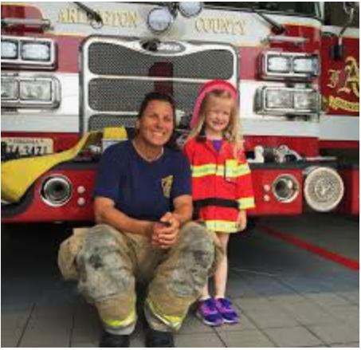

Arlington, Virginia
Population: 238,643
Size: 26 sq. mi.
Unemployment: 2.1%
Race: 61% white*
* White alone, not Hispanic or Latino
Problem: Develop data-informed situational awareness with the goal to improve quality of life and services while accelerating county’s efficiency and resiliency
1st Question: Fire Chief wanted to know if we could link Fire/EMS data end-to-end to recreate incidents to understand resource utilization
Notes:
Set this us as an example to use to highlight the next slides.
Say a couple of words on

Slide 16
Types of decisions
Strategic decision-making — inform and enrich understanding of problems and issues to plan for future operations
Anticipatory decision-making — detect, identify, and warn of emerging issues and discontinuities
Current (tactical) decision-making — support ongoing actions and operations
Adapted from https://www.dni.gov/index.php/what-we-do/what-is-intelligence
Notes:
Time dimension
Strategic (policy orientation versus case study) – bigger picture, future orientation – combine with anticipatory
Tactical – current implementation, e.g. smoke alarm started as a strategic decision and using data analysis implementation through tactical decision-making.
ALSO – Strategic will go with the desire for Prescriptive analytics whereas Anticipatory goes with M&S – ganing experience about possible futures through M&S
Strategic decisionmaking — inform and enrich understanding of problems and issues to plan for future
Anticipatory decision-making—detect, identify, and warn of emerging issues and discontinuities
Current(tactical) decision-making—support ongoing actions and operations

Slide 17
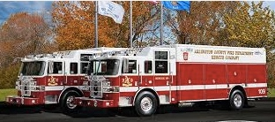
Strategic and anticipatory decision making in Arlington
Question: Fire Chief wanted to know if we could link Fire/EMS data end-to-end to recreate incidents to understand resource utilization
Decisions: Anticipatory and strategic — corpus of data (mash up 911 incidents with local socio-economic data) to support force and resource development

Slide 18
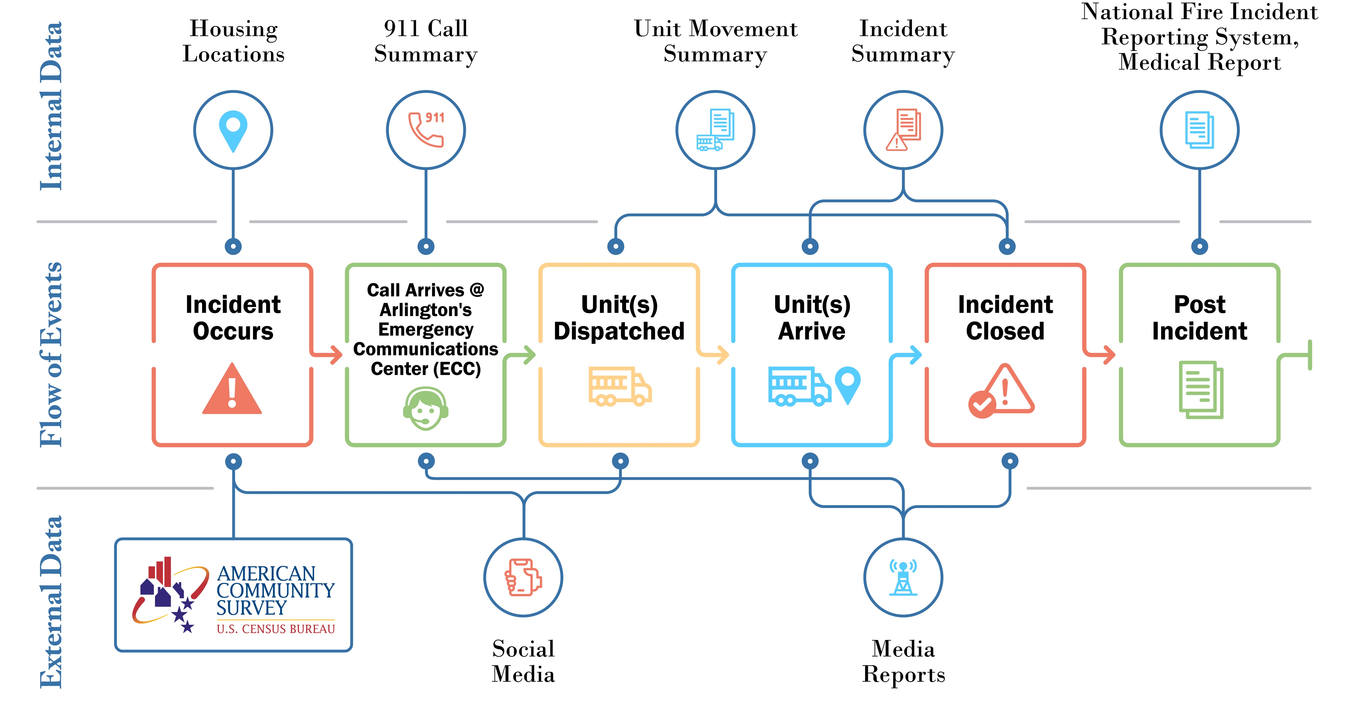
Arlington Fire/EMS data discovery
Notes:
Mash up their systems

Slide 19
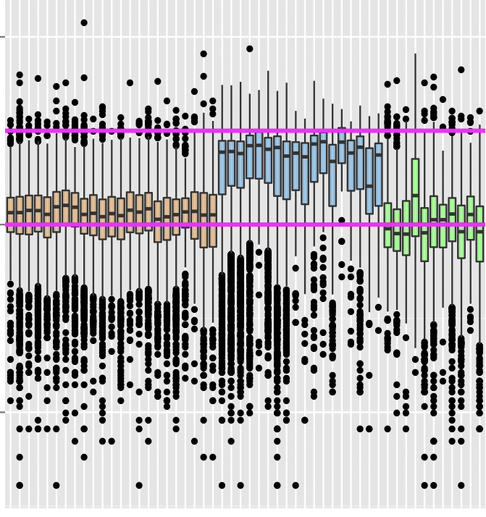
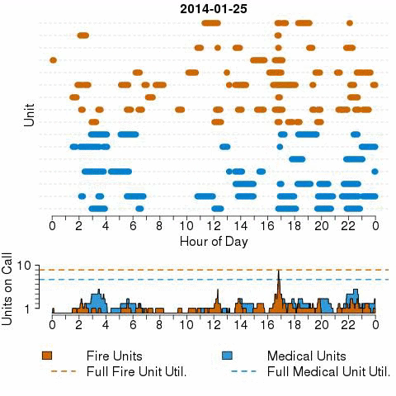
Descriptive: early data insights
Minutes on Call
1,000
10
.1
Fire Units Medical Units Other
Notes:
Repurposing of data and measurement- link the data across time line. SES does not come into play yet. By applying some good explanatory modelsing, can draw inferences.
Run out of units every day at 4:00, where are they? If the lower graph hits the dotted line, units are not available. Are the colors correct?
Minutes that units are on a call – note that the blue bars on the right reflect medical units – they are out much longer than fire units. Black dots reflect outliners. Some black dots below the line are false alarms.

Slide 20
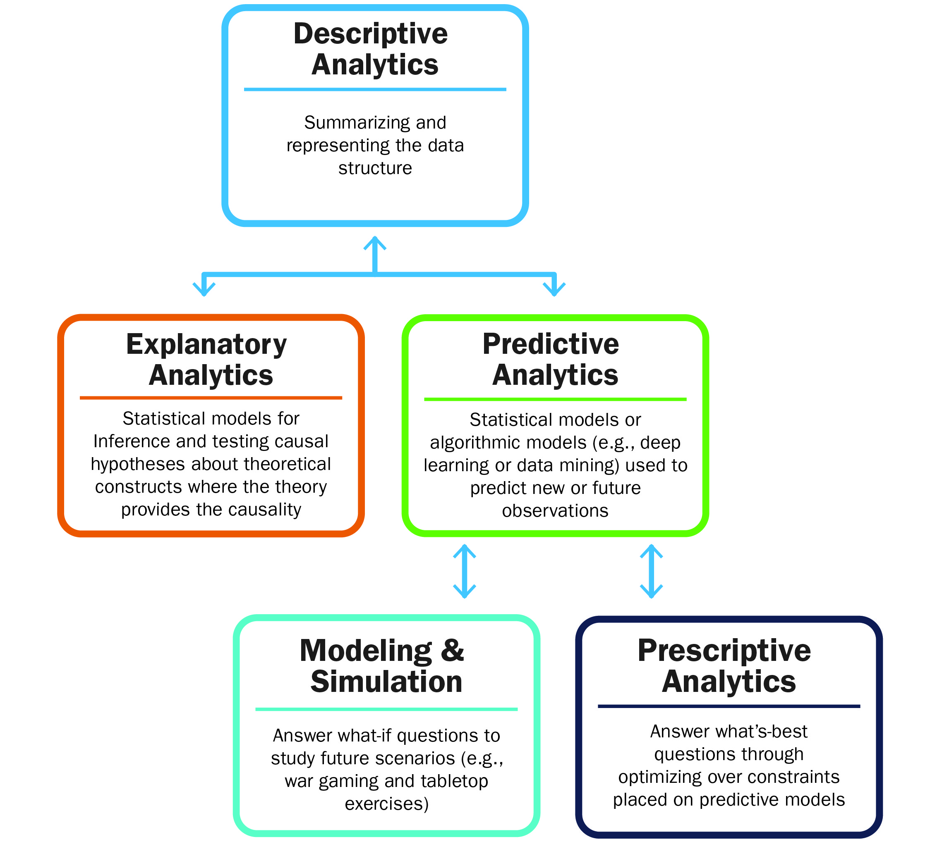
Types of Analyses
Notes:
M&S and Prescriptive should both be called out . This will resonate with the DOD audiences and we can tie it back to the types of decisions --- strategic for prescriptive, if you can get there, and M&S for anticipatory.

Slide 21
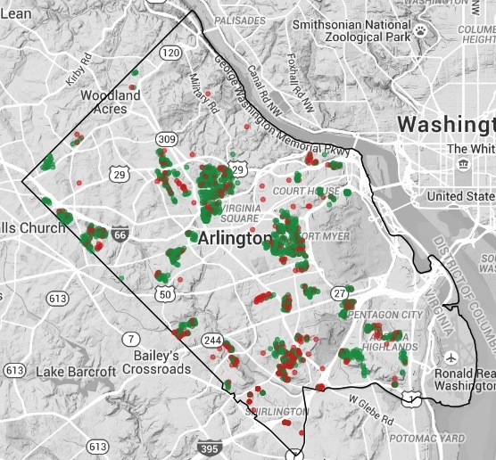
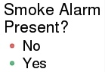
Citizen Safety: Operation Firesafe
Ethics matter
Predictive model: ensuring safety
Ensure at-risk citizens have smoke detectors.
Notes:
NEED TO BRING ETHICS LANGUAGE INTO THIS EXAMPLE
This example could be a good one to highlight ethics – this analysis draws attention to SES disadvantaged homes – is that fair. Also was the original data biased (see next comment) It is also a predictive model example. Also a good way to recap trust in data as there was not a designed sampling plan but we did extensive uncertainty quantification and validated with the new data
Mashed up the fire data with ACS and the AC housing stock – designed data + Admin data + opportunity data!!
Bayesian logistic regression model with conditionally autoregressive spatial effects
Using a Bayesian logistic regression model to estimate the probability that a housing unit has a smoke alarm.
The results show that the Fire Dept. should focus on the southwest (bottom left hand corner) of Arlington.
This is an example of an issue that required mapping multiple sources of different kinds of data to inform a topic.
The model estimates the probability that a housing unit has a smoke alarm.
We fit a Bayesian logistic regression model with conditionally autoregressive spatial effects.
Because of the spatial dependence included in the model, the predictions are made for each residential unit in the CoreLogic data source that are:
in census block groups that appeared in the original data or in a census block group neighboring those in the original data; and
with no missing covariate values and/or census block group information.
Predictions are made for 49,178 residential units.
House Level Predictors:
home value
home age
Block Group Level Predictors:
median income
% single family homes
% living alone
Metrics
• Precision: When the model suggests the home has a smoke alarm, what
percentage of these homes actually have it?
• Recall: What percentage of homes with alarms is the model catching?
When 𝑝" < 𝑡 for threshold 𝑡, the model predicts that household 𝑖 needs a smoke
alarm intervention
• We find the value of t that maximizes precision and recall
Models are trained using repeated holdout samples of 10%, 15% and 20%
of the observations
• For each holdout sample, the model is fit and predicted probabilities are assigned
to the holdout samples
2015 Operation FireSafe data used to estimate the performance of 2016 data
• Then both years were used to make final predictions for 2017
Predictions made at the household level and aggregated to Census block groups

Slide 22
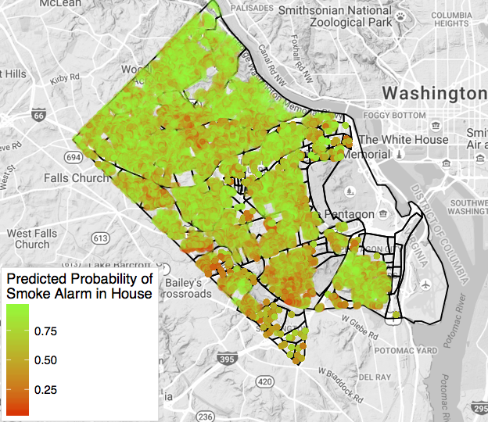
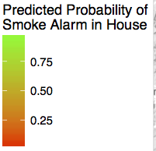
Tactical decisions and actions
Predictive probabilities of smoke alarms
Census Block Level Predictions
Housing Unit Level Predictions
Notes:
Bayesian logistic regression model with
conditionally autoregressive spatial effects
Using a Bayesian logistic regression model to estimate the probability that a housing unit has a smoke alarm.
The results show that the Fire Dept. should focus on the southwest (bottom left hand corner) of Arlington.
This is an example of an issue that required mapping multiple sources of different kinds of data to inform a topic.
The model estimates the probability that a housing unit has a smoke alarm.
We fit a Bayesian logistic regression model with conditionally autoregressive spatial effects.
Because of the spatial dependence included in the model, the predictions are made for each residential unit in the CoreLogic data source that are:
in census block groups that appeared in the original data or in a census block group neighboring those in the original data; and
with no missing covariate values and/or census block group information.
Predictions are made for 49,178 residential units.
House Level Predictors:
home value
home age
Block Group Level Predictors:
median income
% single family homes
% living alone
Predictive Performance:
Metrics
• Precision: When the model suggests the home has a smoke alarm, what
percentage of these homes actually have it?
• Recall: What percentage of homes with alarms is the model catching?
When 𝑝" < 𝑡 for threshold 𝑡, the model predicts that household 𝑖 needs a smoke
alarm intervention
• We find the value of t that maximizes precision and recall
Models are trained using repeated holdout samples of 10%, 15% and 20%
of the observations
• For each holdout sample, the model is fit and predicted probabilities are assigned
to the holdout samples
2015 Operation FireSafe data used to estimate the performance of 2016 data
• Then both years were used to make final predictions for 2017
Predictions made at the household level and aggregated to Census block groups

Slide 23
What are our obligations to use these data ethically?
11
Notes:
In the Netflix docudrama, the Social Dilemma, former employees of Google, Facebook, and social companies state that these companies are using massive data mining to design their products to be addictive. This surveillance capitalism is made possible throughs accelerating advances in machine learning. The results appear to have led to increasingly poor adolescent mental health and the spreading of conspiracy theories.
The film is optimistic in thinking that we can achieve the benefits of these consumer technologies while minimizing the harm to individuals and society. How do we achieve this balance in our research? Today, I will present examples and a history of how research has evolved to achieve this balance. But as the Social Dilemma advocates state, it takes time to do this! In the case of research, it took over 30 year find the balance of excellent research tempered by policies that ensure ethical behavior of researchers. As I will demonstrate, the process is still evolving as we make use of the massive amounts of data that continue to grow at exponential scales.

Slide 24
The Belmont Report
The Belmont Principles provide the foundation for the Institutional Review Board (IRB) process and for a principles-based approach to ethics.
Respect for persons – honoring individual wishes
Beneficence – weighing risks and benefits of study
Justice – fair distribution of risks and benefits
Led to the Common Rule which governs U.S. Government research
Focus is on “research involving human subjects”
1979
Notes:
Let’s step back and review the history related to research and ethics.
The Belmont Commission was convened in the late 1970s after ethical failures by researchers became known.
The most famous example of one of these failures is the Tuskegee Syphilis Study conducted from 1932-1972 to observe the natural progression of untreated syphilis of poor African-American men.
None of the men were told that they had the disease, and none were treated with penicillin even after the antibiotic was proven to successfully treat syphilis.
The Belmont Commission issued 3 principles for the conduct of ethical research
These principles are
Respect for persons – treating people as autonomous and honoring their wishes
Beneficence – understanding the risks and benefits of the study and weighing the balance between (1) do no harm and (2) maximize possible benefits and minimize possible harms.
Justice – deciding if the risks and benefits of research are distributed fairly
The principles were codified into law and are now referred to at the Common Rule.
The Belmont Report provided the foundation for the Institutional Review Board’s principles and focus on ‘research involving human subjects.”

Slide 25
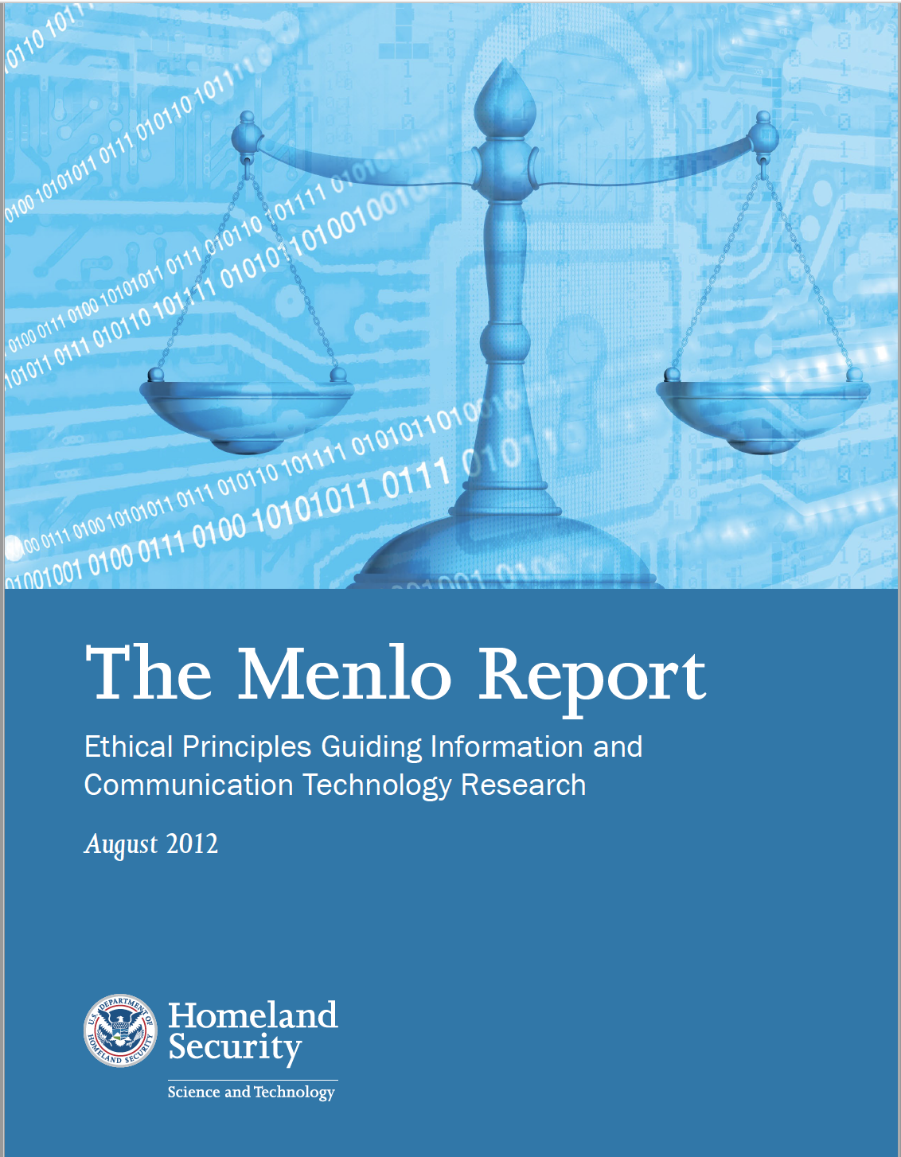
The Menlo Report
Department of Homeland Security commissioned a report to introduce Belmont principles in ICT (Information, Communication, Technology)
The Menlo Report extends the Belmont Principles to include Respect for Law and Public Interest
Focus is on “research with human-harming potential”
2012
Notes:
The Menlo report was commissioned by the Department of Homeland Security to bring the Belmont principles to the Information, Communication, and Technology or ICT community.
They also expanded the Belmont principles in two important ways:
They added a 4th principle - Respect for Law and Public Interest – extends principle of beneficence to include all relevant stakeholders
And they expanded the focus to include “research with human-harming potential,” not just a focus on “research on human subjects.”
This change is important in the digital age where the use of digital technologies and repurposing of data can expose people to risks.
We recommend that our projects should embrace the broader criteria set forth in the Menlo Report.
Data scientists can lead the way.

Slide 26
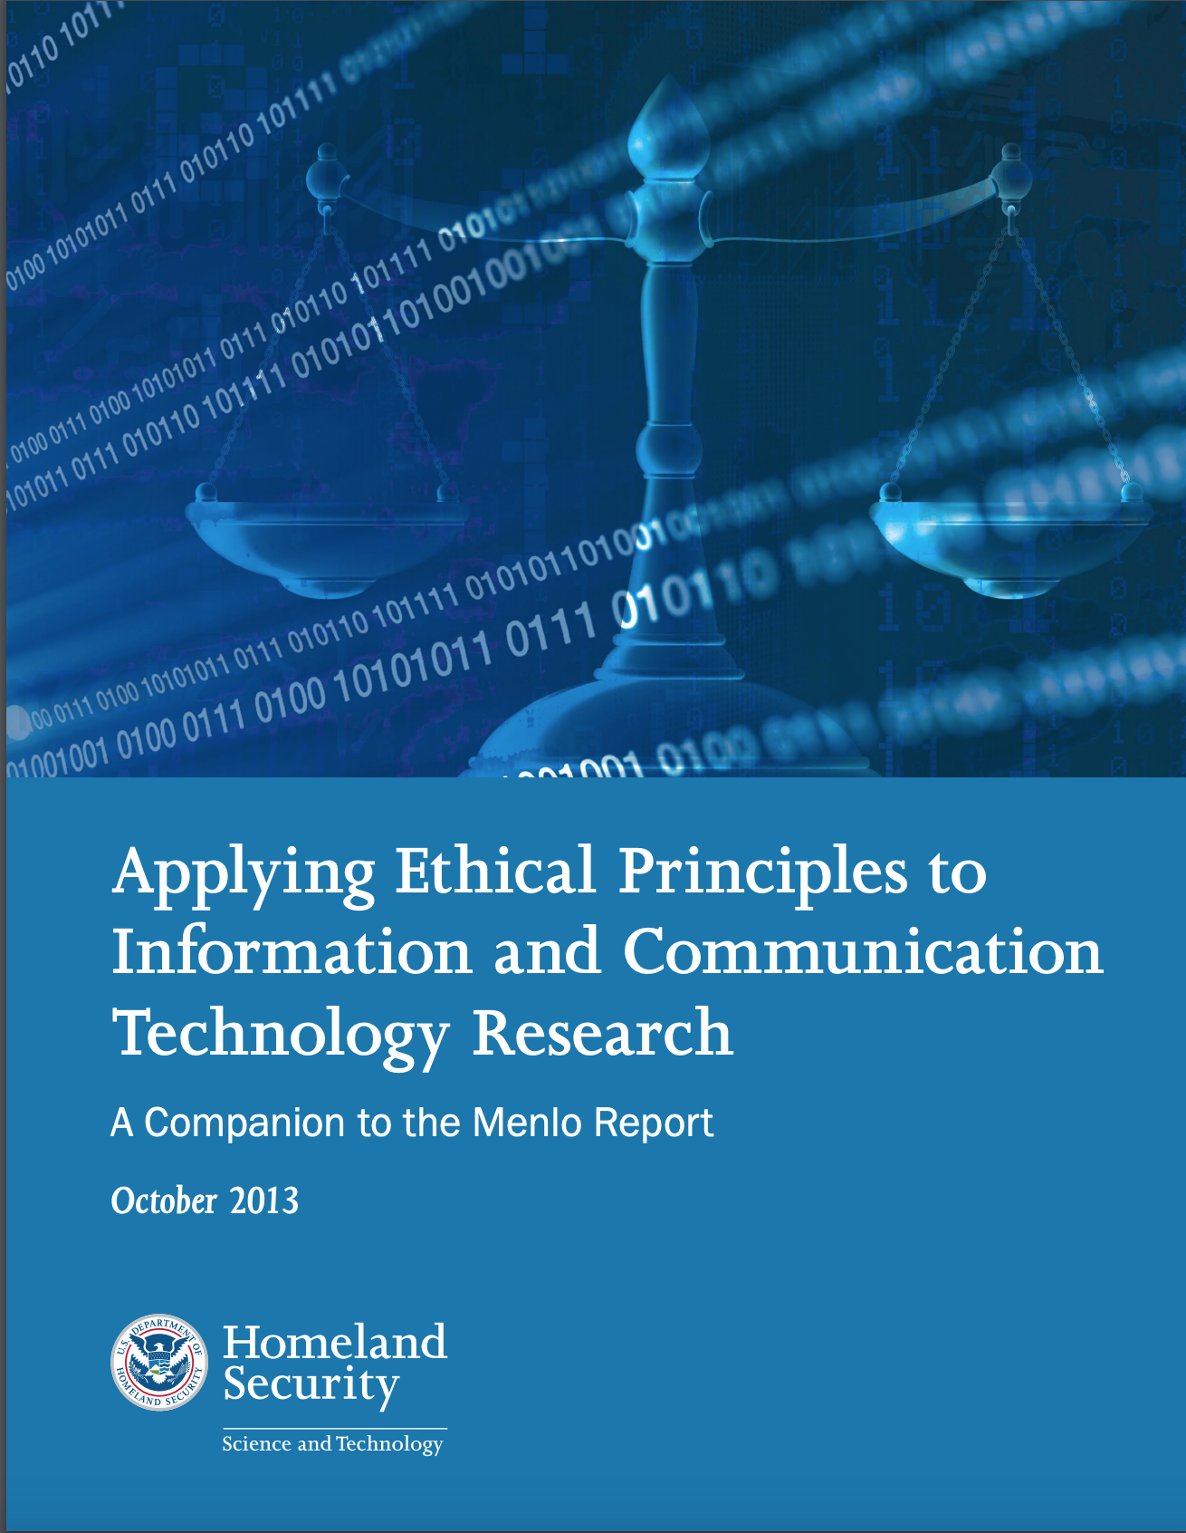
The Menlo Report Companion Report
Outlines a framework to manage ethics challenges in the IT environment; i.e., data revolution
Why is the new environment different?
Scale – massive datasets available
Speed – efficiency, produces results that affect millions
Tight coupling – interconnected resources via networks.
Decentralization- Text, audio and video communications located in many different places
Wide distribution - spatial distribution can cause research activity to negatively impact the integrity or availability of information and information systems
Opacity - users are not privy to the inner workings of applications, devices and networks
18
https://www.nature.com/articles/d41586-019-01720-7
Notes:
We recommend that our projects should embrace the broader criteria set forth in the Menlo Report.
Although the focus of the Menlo reports is for computer scientists, underlying this is the revolution in data that now allows us to access, repurpose, and use massive amounts of data in our research.
The Menlo Report extended the Common Rule by focusing on benefits to society. W
Why is the new environment different?
Scale – massive datasets available
Speed – increased efficiency of our IT systems means that we can quickly produce results that affect millions
There is Tight coupling of ICT resources that are interconnected via networks. For example, smart phones may contain a vast array of sensitive data. Think of our smart phones that likely contains much information personal contacts linking names, addresses, phone numbers, email addresses, social network accounts, and family members; passwords for financial, utilities, insurance, or investment accounts; applications allowing remote control of home appliances and automobile
The next three can negatively impact research activities that depend on cooperation, such as obtaining informed consent and mitigating actual harms because the data are decentralized, widely distributed, and are opaque in that data users are not privy to the inner workings of applications, devices and networks. The
They provide examples of Qs and case studies…
Decentralization - Text, audio and video communications may be located in many different places and controlled by various entities, yet converge at various places and times to convey information. This decentralization Wide distribution - spatial distribution can cause research activity to negatively impact the integrity or availability of information and information systems
And there are Opacity challenges. Generally, users are not privy to the inner workings of applications, devices and networks. The simplicity of user interfaces hides the technical details of storage, transmission protocols, rendering, resource management and credentialing that ensure seamless usability and enhanced functionality. Many risks are not perceptible to the user, nor is it clear what system functions are normal or what is caused by researcher activity. This complicates informed consent because of the limitations of non-technical individuals to understand risks associated with ICT. Opacity may also effect determinations of information quality and reliability.

Slide 27

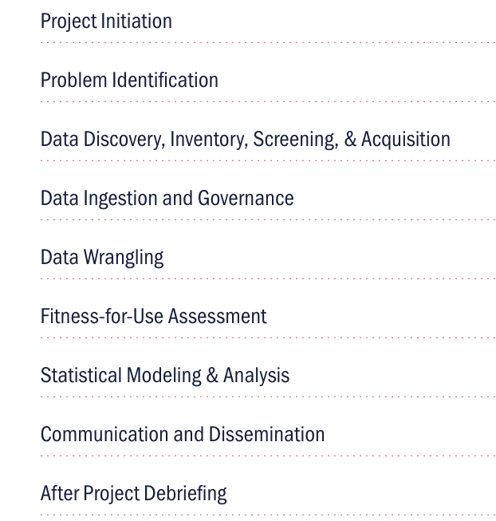
Adapt criteria to ensure implementation of ethical principles into the project
Make discussion of ethics and implicit biases a continuous part of the project
Seek expert help when ethical questions at any stage cannot be answered by the research team
Incorporate ethical guidelines from relevant professional societies
Ensure documentation, transparency, ongoing discussion, and constructive criticism throughout the life of project
Data Science Ethics Discussion Guide
https://biocomplexity.virginia.edu/data-science-ethics
Notes:
Every research project should include a Data Science Ethics checklist at each phase of the project.
A key part of this checklist is the assessment of implicit biases throughout the project.
The ethical principles involved here require instilling ethics into all data science research practices that is reflected in project documentation, transparency, ongoing discussion, questioning, and constructive criticism.
A publicly-shared ethics checklist starts with the project planning phase that encompasses the entire project, not just completion of the Human Research Protections Program IRB process.
The IRB approval is necessary but not sufficient for addressing a researcher’s ethical responsibility in his/her research.
The checklist provides a mechanism to ensure that ethical principles be discussed throughout the project informally and formally at specific milestones.
Just having a checklist does not mean that this is easy. The checklist is a reminder that dialogue is needed at every stage of the research/.

Slide 28
Data acumen: how to use data to inform decisions?
What is the problem? What are the questions?
What type(s) of decision needs to be made?
What data are available? Why should I trust the data?
What type of analyses are needed to inform the decision?
What are the ethical considerations?
What part of the data science process are we discussing?
Notes:
What is the problem? (question refinement)
What type of decision needs to be made? (strategic, anticipatory, tactical)
What data are available? Why should I trust the data? (data discovery)
What type of analyses are needed to inform the decision? (descriptive/exploratory, explanatory, predictive, modeling & simulation, prescriptive)
What are the ethical considerations? (integrated into all parts of the process)
What part of the data science process is being discussed with me? (clear communication and dissemination throughout the entire data science process)

Slide 29
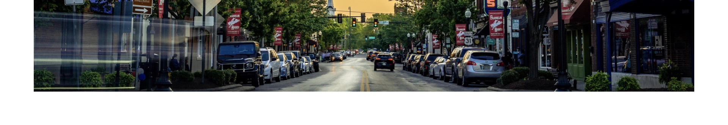
Notes:
We wanted to know how to scale this beyond one locality and one state.
We are asked this all the time.
This brings us to another phase of our work that is really exciting.
It is around building a national community learning network.
To do this, we need to figure out partners.
And some of these discussions started back at Virginia Tech.
I would like to give a call out to Ed Jones, who just retired as director of the Virginia Cooperative Extension, and Mike Lambur who has been a partner with us since we initiated this idea.
To scale our work, we need a partner who is out there in the field in the communities
We are the data and modeling guys and not in all these communities,

Slide 30
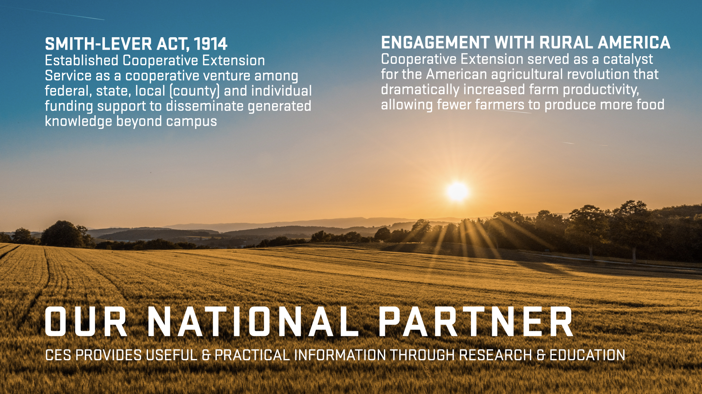
Notes:
As you know, the Cooperative Extension System started in 1914 as part of the Smith-Lever Act.
It has been around for a long time and it is a trusted network of professionals in every community.
These professionals are tethered back to the Land Grant Universities.
That is where they get their reach back for community-based research.. That is how they reach back to researchers to study things about agriculture, animal husbandry, agronomy and now data science.
Those are our partners

Slide 31
Notes:
As we have been working with Cooperative Extension, we asked them if you had access to data, data science expertise, and training, how might you use it? This is what they tell us.
Measure capacity for new community development projects.
They would be competitive for new grants that these communities need.
They would be able to better define their own programming.

Slide 32
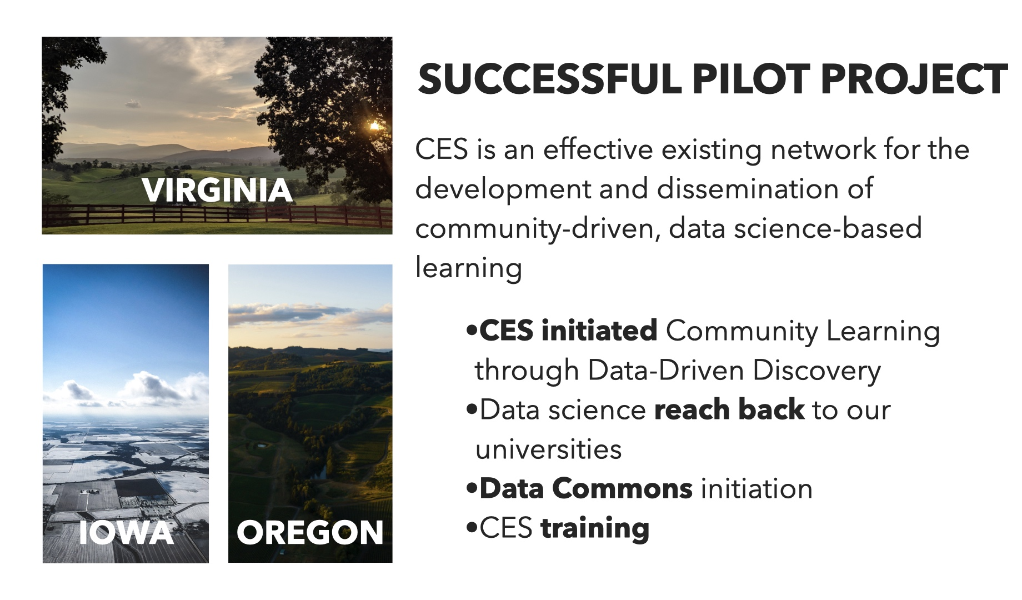
Notes:
So we said ok.
We received funding from the Bill and Melinda Gates Foundation and the USDA NIFA
And we did a pilot across Virginia, Iowa, and Oregon to test out what Cooperative Extension could do to engage in Community Learning through Data Driven Discovery process,.
Could they engage with communities to bring data insights to help communities thrive?
And the answer is YES, this was highly successful.
I want to give a shout out to Susan Chen in the AG ECON DEPT WHO HAS CONTINUED THIS WORK WITH A USDA NIFA GRANT.

Slide 33

USDA FARM BILL PROPOSAL
CREATING A NEW PURPOSE for 2023
NEW PURPOSE
Develop and sustain a national network of Community Learning through Data Driven Discovery (CLD3) partnerships that integrates data science and Cooperative Extension expertise.
Support the network with a curated National Data Commons to ensure equitable evidence­ based program and policy development and practice.
American Association of Public and Land Grant Universities (APLU)
Extension Committee on Organization and Policy (ECOP)
Notes:
This has now led to our involvement in a national conversation about getting a new purpose for the Cooperative Extension into the 2023 Farm Bill.
The Farm Bill is rewritten every 5 years.
It carries with it about $500 Billion dollars in programs.
Funding for cooperative extension comes out of this bill.
Cathie Woteki, one of Biocomplexity's Distinguished Institute Fellows and the former under-secretaries at the USDA's Research, Education, and Economics mission area, as well as the department's chief scientist. She has been our lead advocate for this initiative. Will note that she is also a Virginia Tech Alum.
So the new purpose would be to develop community learning through data-driven partnerships across the country.
Part of the bill is to provide support to create a national data commons to provide the data they need to bring data insights to their community.
We are working with the American Association of Public and Land Grant Universities (APLU) to support this.
In Virginia, we are working with VCE to adopt our data commons to update the situational awareness data through a data commons.

Slide 34

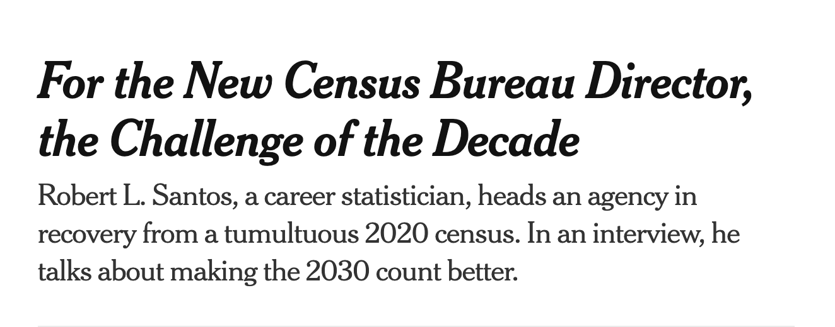

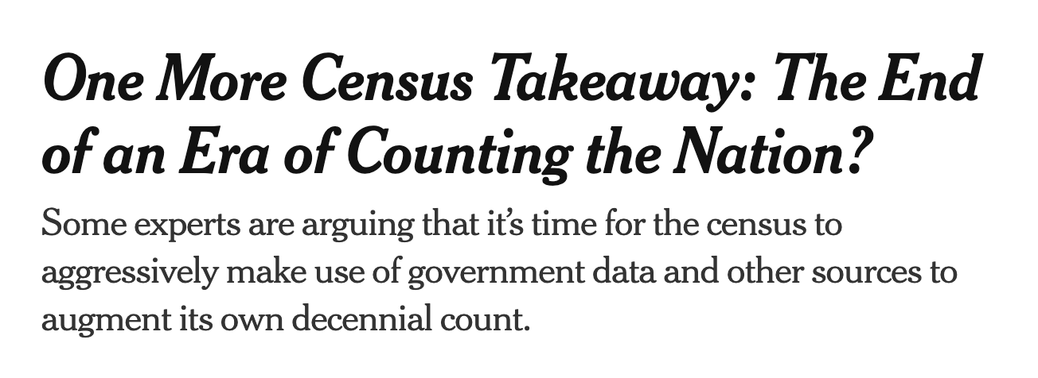
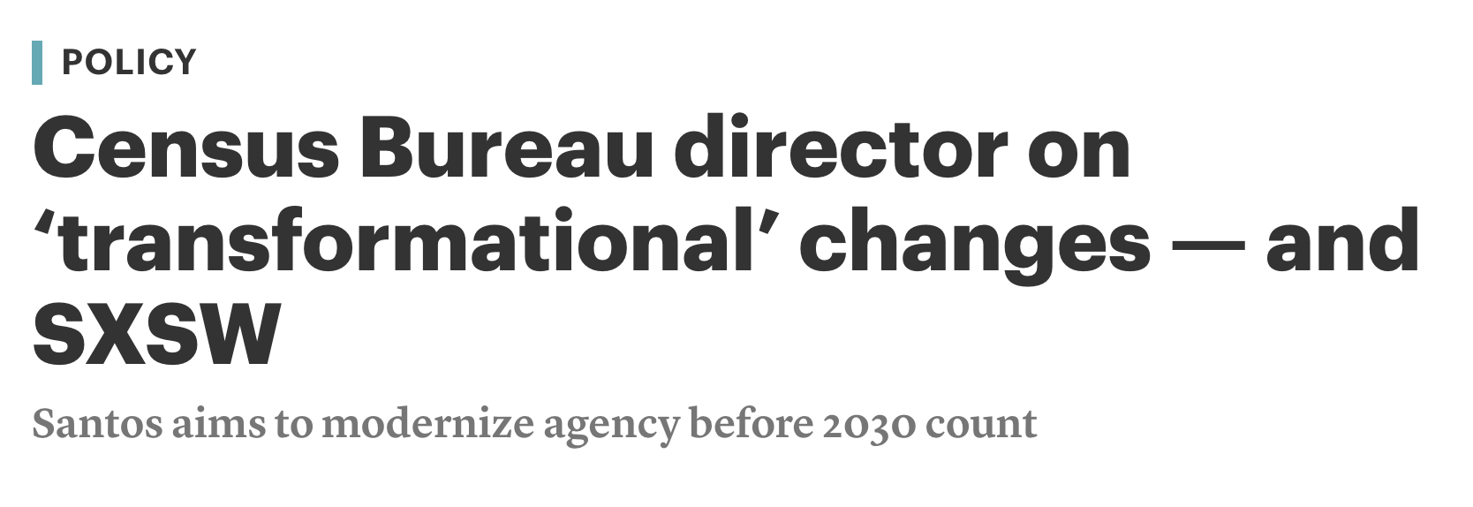

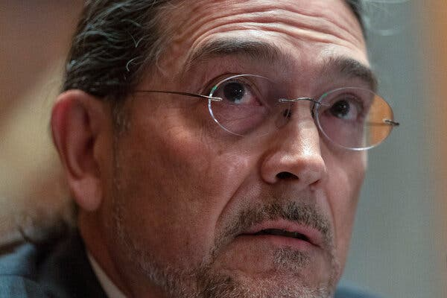

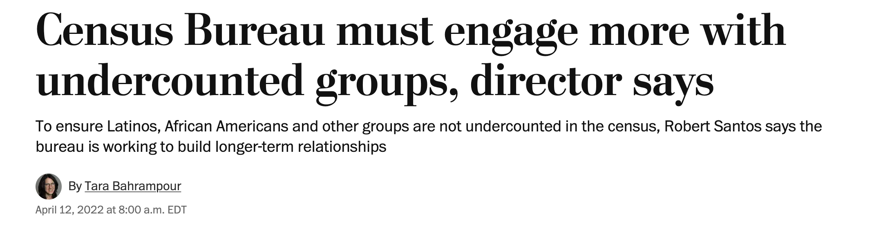
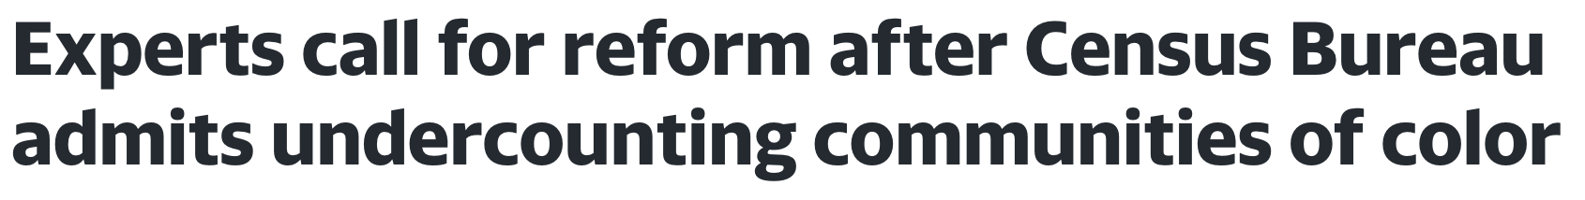
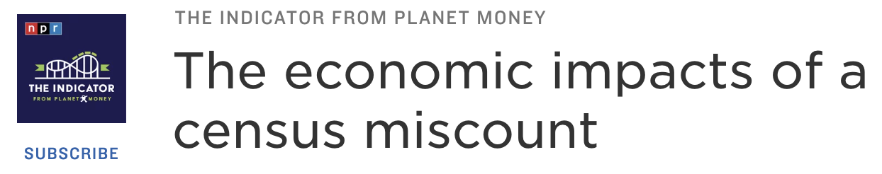
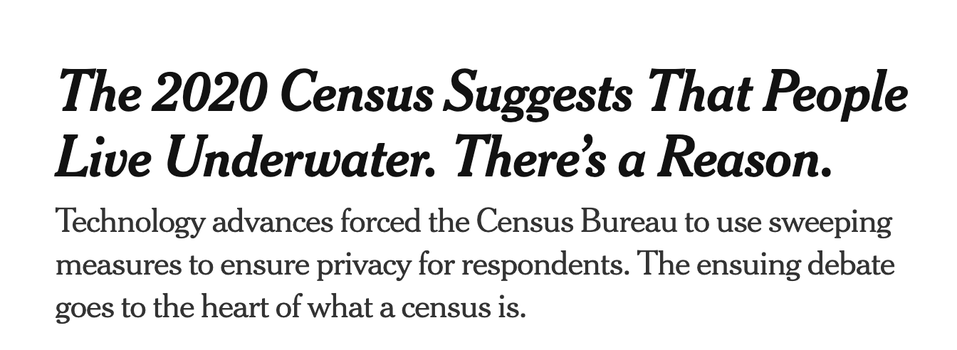

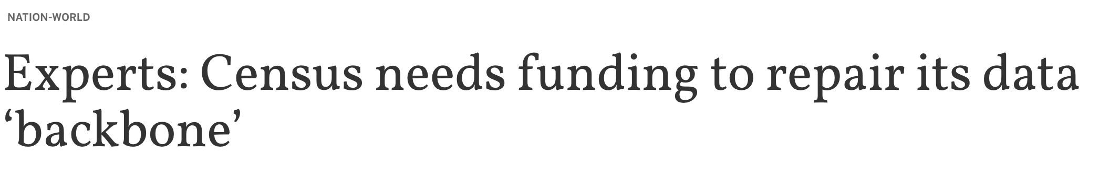
U.S. Census Bureau in the News
Notes:
That is our local work that is taking a national feel.
Now switching to a national level that is influenced by local work but coming from a national level rather than a grassroots end is the Census Bureau.
You have likely noticed them in the news.
Particularly since the 2020 census and the fall out from political interference in the process and a new director.

Slide 35
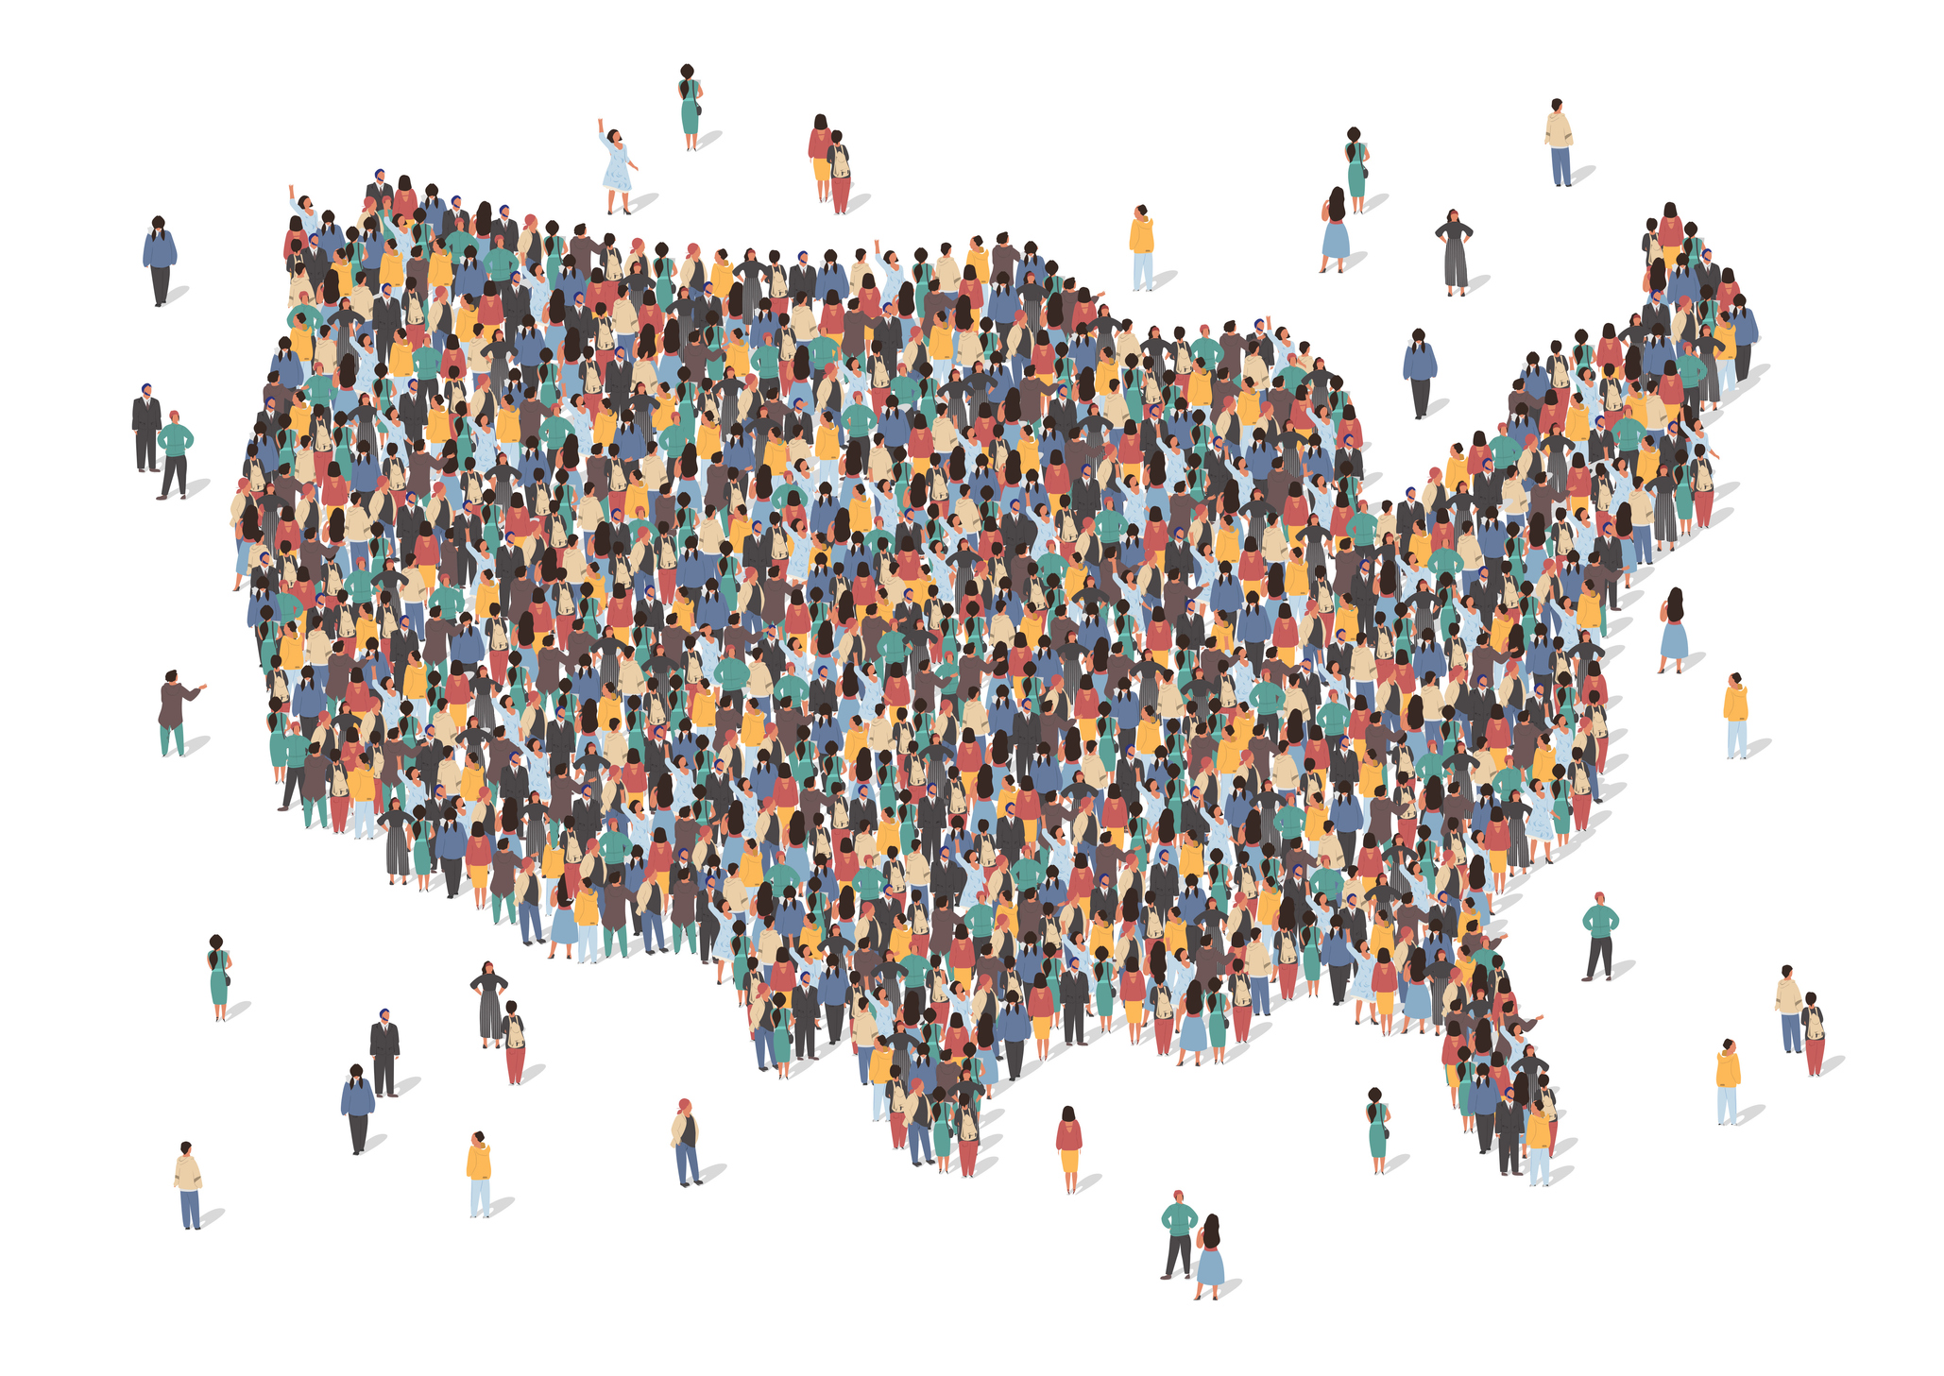


21st Century Census Bureau
What are the opportunities?
Notes:
There is an opportunity to do something here!
That is where we come in.
What is the 21st-century Census Bureau’s opportunity?
Can we work with them and the federal statistical system to change the landscape?
We have been working with them for the last 3 to 4 years and it is gaining momentum right now.
We are motivating a major paradigm shift for the Bureau and federal statistics.

Slide 36


















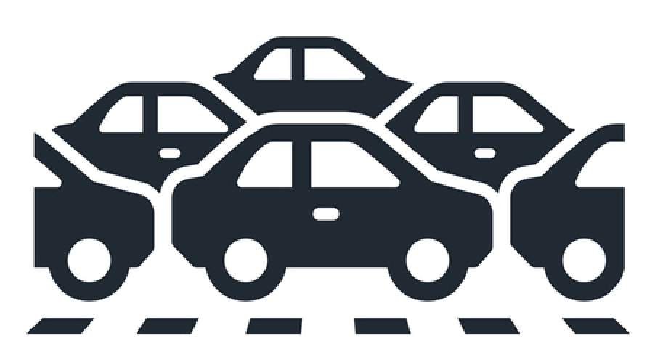
Paradigm Shift for Census Bureau: Focus on Purpose and Use
With the accelerating pace of change in our society and economy, we must constantly innovate how we collect and report official statistics to understand who we are, and where we are going.
Equity and Inclusion
Counting Children
Family Units
Rural Communities
Local Businesses
Tribal Areas
Vulnerable Populations
Elderly Residential Care
The Unhoused
Migration
Climate Change
Gig Economy
Workforce Automation
Differential Undercount
Broadband Deployment
Emergency Preparedness
Economic Mobility
Commuting Patterns
Changing Demographics
Notes:
We are motivating a major paradigm shift for the Bureau and federal statistics.
This shift focuses on how to use all the data available that exists to support the different purposes and uses
As opposed to the current focus on individual surveys and individual data elements.
Let’s rachet that up to think about how to use all this information to study complicated problems of which you see on this slide.
Many of them currently addressed using exisitng survyes in silos and only focus on one part of the problem.

Slide 37
Introducing the Curated Data Enterprise
The U.S. Census Bureau has begun modernization activities towards creating a universal frame that could form the foundation for a transformative capability to integrate the Bureau’s demographic and economic surveys and censuses with administrative and third-party data.
We describe this new, innovative state as a Curated Data Enterprise (CDE).
Both an infrastructure and a continuously evolving ambition to empower and enable Bureau scientists and their data users to develop new measures of people, places, and the economy.
Exploits multiple data sources, from sample surveys, censuses, and other official administrative and third-party data, which can provide more robust, timely, and comprehensive measures when combined.
CURATED DATA
ENTERPRISE
The Census Bureau of the Future
37
Notes:
I want to introduce an idea that we have called the Curated Data Enterprise.
The Curated Data Enterprise leverages existing Census Bureau activities and modernization and innovation that the Bureau is doing to an uber model of gathering and integrating massive amounts of data.
These data sources are the same ones we have discussed – administrative data, third-party data, and data the bureau already collects together to focus on these purposes and uses.
This is both a concept of physical infrastructure that we are helping to define as well as an ambition for the Census Bureau.
As you all know, the Census Bureau does much more than the decennial enumerator every 10 years.
They collect economic data that measures our business sector and demographic data that measures the household side of the economy.
We are talking about their 130 surveys coming together and combining them with new sources of data.

Slide 38

Early Discussions with Experts
Advice Received
Rebuild trust with stakeholders.
Partner and engage with local governments to build their capacity to use Bureau data products
Provide data products to meet data users at all levels of expertise
OMB: Support a decadal budget.
Congress: Protect Bureau from political interference.
Stakeholders: Acknowledge there will be trade-offs embedded in new strategies and seek input and cooperation in making choices.
How will CDE change stakeholder’s approach to their research and activities?
What are the implications for state, local, and tribal governments in their ability to identify and address needs and create informed policies?
What will be the barriers for development and adoption?
38
Notes:
We have discussed this experts and stakeholders.

Slide 39
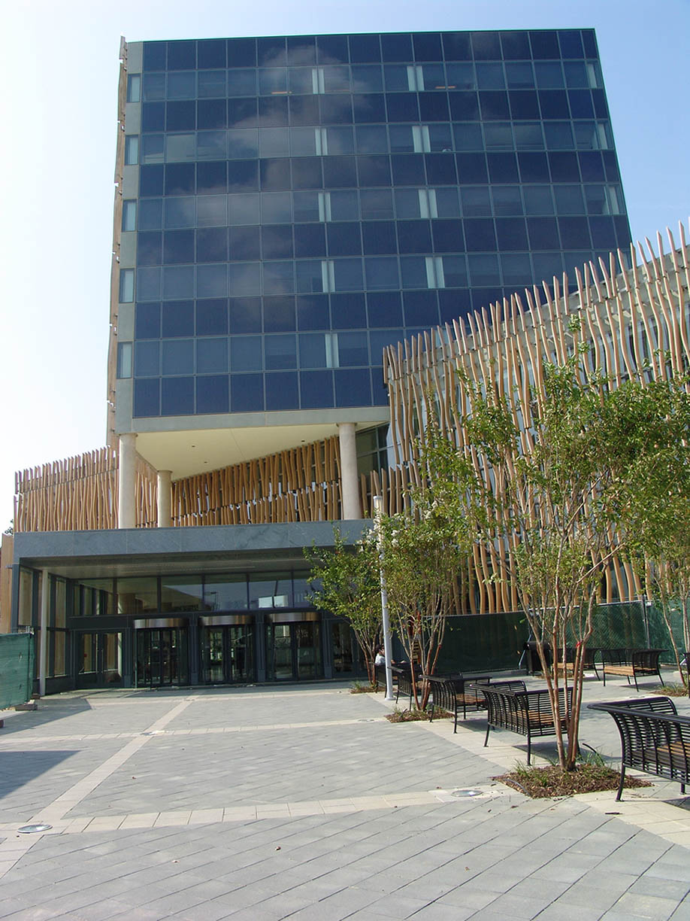
Census Bureau MOU Tasking
Identify and Characterize Stakeholder Communities
“
UVA will conduct workshops, webinars, and other activities with stakeholders to culminate into a comprehensive communication and outreach strategy relative to the innovation and modernization opportunities for the Census Bureau during this next decade.
UVA will synthesize findings from workshops, webinars, and other activities with stakeholder communities to highlight big opportunity areas, technical challenges, and barriers to the innovation and modernization opportunities for the Census Bureau during this next decade.
“
Develop a Research Agenda
“
“
Notes:
Our original objective for “Envisioning Census 2030 – Creating a National Plan” was to present a framework for a more efficient, accurate, less costly Decennial Census coupled with a more robust ACS, and to share this vision with multiple census stakeholders for their consideration. In the process of moving along this track, our view has evolved to and aligns with the Census Bureau’s work to create a nationally integrated person-household-business-jobs frame, with the decennial census providing the critical recalibration denominator for all survey data, as well as the reapportionment and federal funds distribution statistics. This could result in a universal statistical frame that will form the new foundation of social science research, providing complete longitudinal data.
The development of this universal frame enlarged the project’s initial focus of a stripped-down Census to capture state counts. This core task remains, but it was too narrowly conceptualized. We have shifted, provisionally, to this broader terminology: an Essential-Data Count of the Resident Population coupled with a 21st Century Census Curated Information Platform.

Slide 40
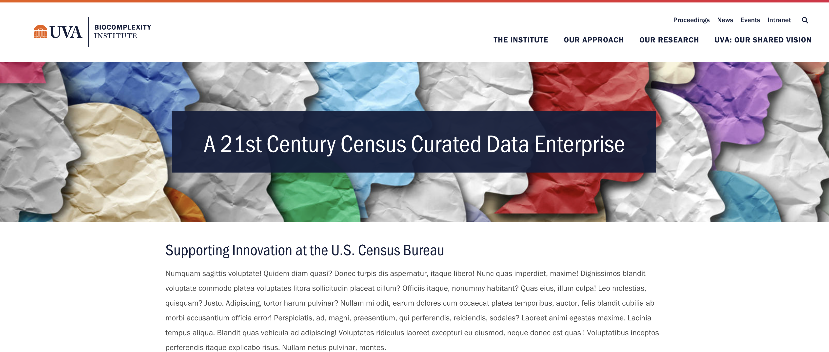
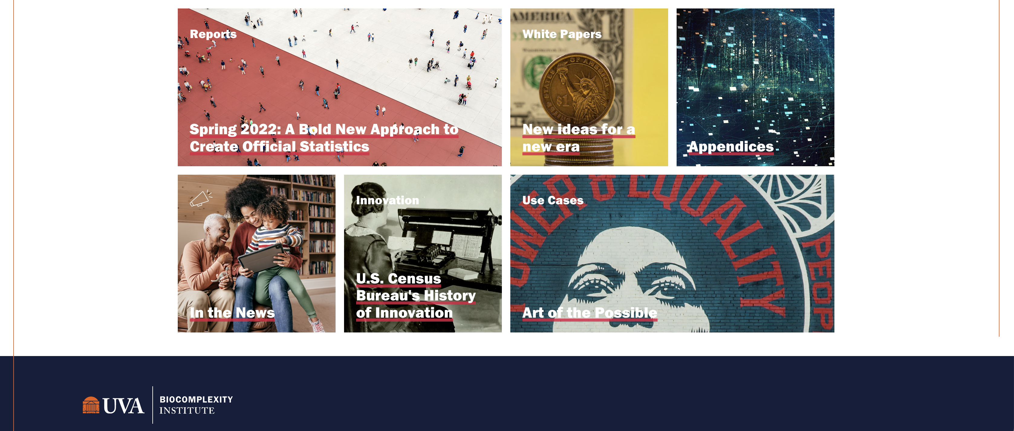
Notes:
So that has led to a discussion with the Census Bureau and stakeholders that care about the the data collection and content.
We are proposing what we call this a Curated Data Enterprise.

Slide 41
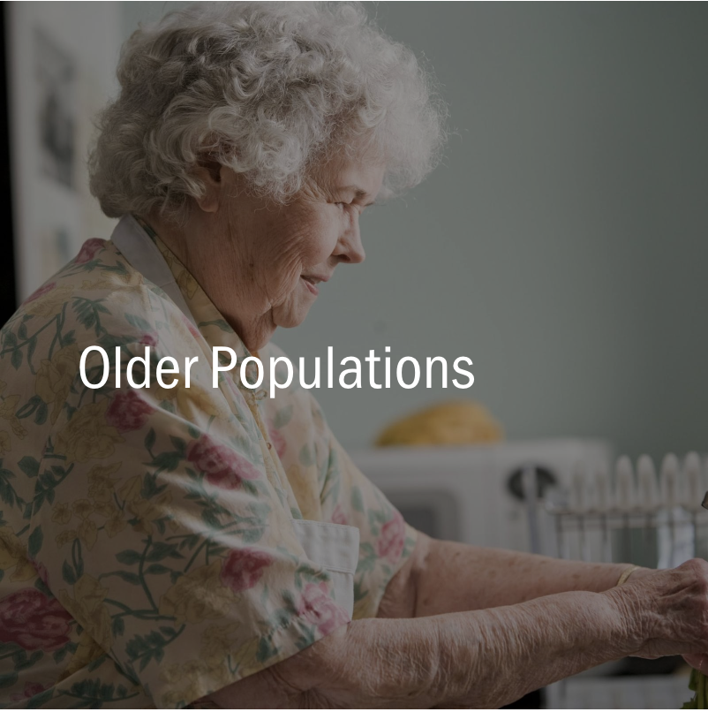
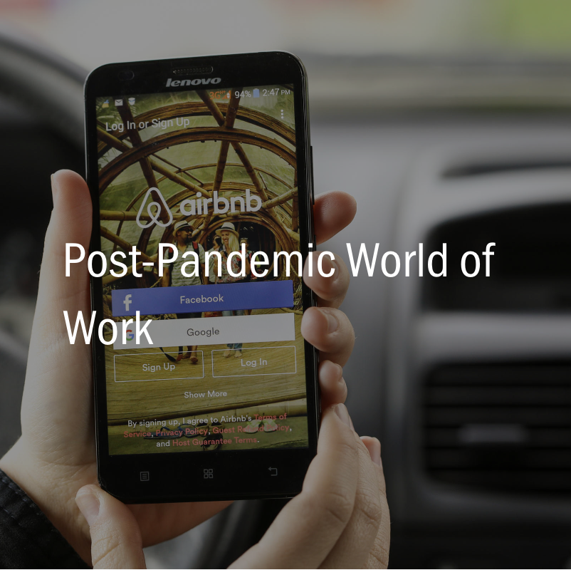
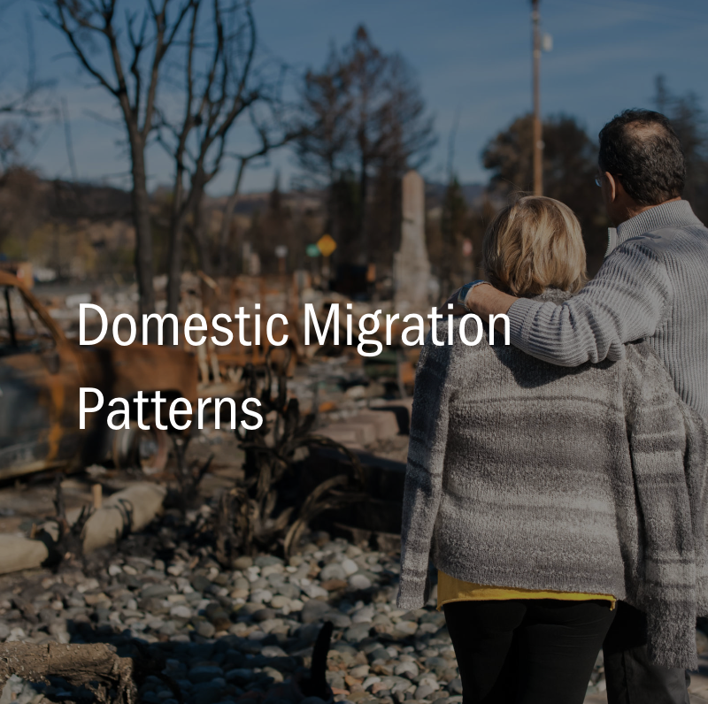
Use Cases - Three Compelling Examples of “Purpose and Use”
Use Case - a research method to identify, clarify, and organize requirements to create a system or overall system component, such as the Curated Data Enterprise.
Goal: Build the CDE Use Case by Use Case.
Notes:
Use my definition here, Bring in Ethics.
CDE opens new opportunities to measure changing economic and social conditions
Requires real-time and geographically detailed data to address questions asked by policymakers, media, analysts, researchers, planners, advocates, and the public.
Provides window into the possible powered by Census data assets combined with administrative and third-party data that could be enabled through the CDE.
The proposed Curated Data Enterprise (CDE) opens new opportunities for measurement associated with changing economic and
social conditions that simply have not been achieved historically. For example, pandemics, wild res, hurricanes, and changes in
work require real-time and geographically detailed data to address questions asked by policymakers, media, analysts, researchers,
planners, advocates, and the public. The CDE is thus intentionally focused on the purpose and uses of the Census Bureau’s data,
and will identify and anticipate the challenges of discovering, integrating, and using data in unexpected new ways. The exemplars
below demonstrate the art of the possible as well as their associated technical challenges. They are just a window into the possible
powered by the Bureau’s incomparable data assets that could be enabled through the CDE.

Slide 42

American Statistical Association
A. Professional Integrity and
Accountability
New Place!
B. Integrity of Data and Methods
H. Responsibilities Regarding Potential Misconduct
Ethical Guidelines
New!
C. Responsibilities to Stakeholders
G. Responsibilities of Leaders, Supervisors, Mentors in Statistical Practice
8 principles
60+12 elements
D. Responsibilities to Research Subjects, Data Subjects, and those directly affected by statistical practices
F. Responsibilities to Fellow Statistical Practitioners and the Profession
E. Responsibilities to Multidisciplinary Team Colleagues
New!
+APPENDIX. Responsibilities of Organizations/Institutions
2022 Guidelines

Slide 43
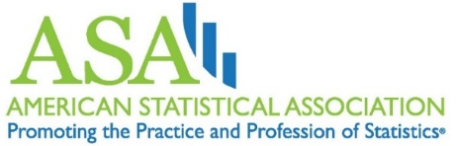
American Statistical Association Responsibilities to Fellow Statistical Practitioners and the Profession (section F)
Example of Topics covered
Use constructive discourse to focus on scientific principles and methodology and not personal attributes.
Help strengthen the work of others through appropriate peer review or consultation.
Take full responsibility for their contributions as instructors, mentors, and supervisors of statistical practice.
Promote reproducibility and replication, whether results are “significant” or not, by sharing data, methods, and documentation to the extent possible.
Serve as an ambassador for statistical practice.

Slide 44
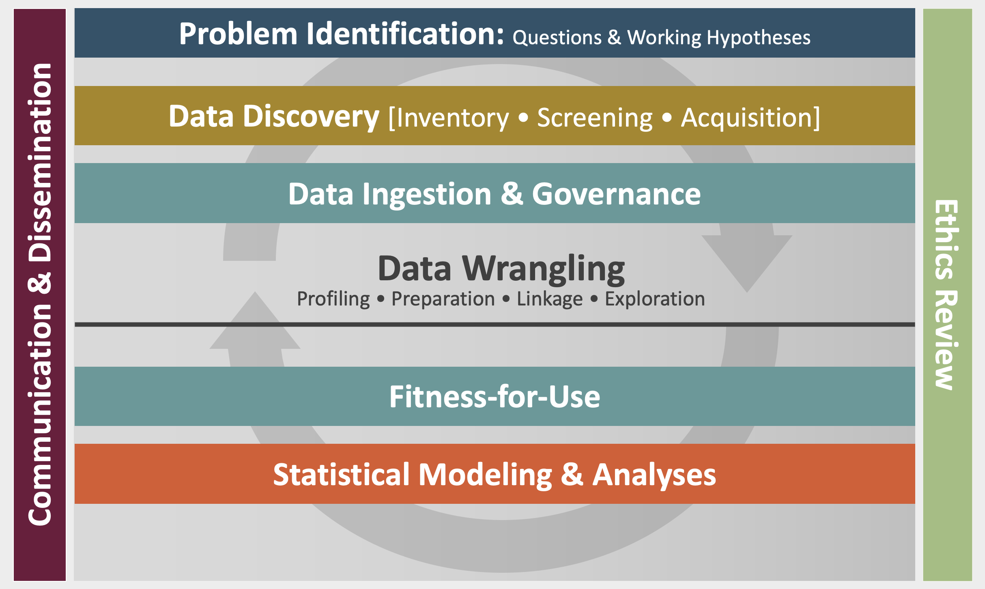
Our Data Science Evolution
Data Science is learning from data in the context of problems
Data Science Framework enables creation of repeatable and measurable processes for the use & repurposing of all data sources
Data acumen is the ability to make good judgements about the use of data to support problem solutions
Type of decisions is critical for understanding the value of analysis
Ethics and communication must be integrated throughout the data science process
Notes:
Research model
DSF
Community Engagement Model CLD3
This led to think about and define data acumen

Slide 45
American Statistical Association (ASA) Ethical Guidelines, Webinars, and Podcast
The Data Science Ethos https://ethos.academicdatascience.org/
ASA Ethical Guidelines for Statistical Practice https://www.amstat.org/your-career/ethical-guidelines-for-statistical-practice
ASA COPE Ethical GLs webinars
May 26, 2022 Part 1 webinar emphasized the Principles A, B, C, D (https://youtu.be/cUpRNEgv5WU)
June 9, 2022 Part 2 emphasized the Principles E, F, G, H, Appendix (https://youtu.be/rGtlUSldOSE)
Practical Significance | Episode 22: What’s in the 2022 Ethical Guidelines for Statistical Practice?
https://magazine.amstat.org/blog/podcast/practical-significance-episode-22-whats-in-the-2022-ethical-guidelines-for-statistical-practice/

